Slide 1


The programmers team
ANDREAS KYRIAKIDES
SIMOS MICHAEL
MAHMOUD TALEB
MATHEOS CHRISTODOULOU

Slide 2
The Student Management System
The Programmers Team is a group of 4 college students on their 1st year of study computer & network technician.
Our names are :
Simos , Antreas , Matheos , Mahmout.
We came up with the idea to create a student management system to help our college to contribute to the student and professors records data management!

Slide 3
The Student Management System complete code

Slide 4
Student Management Analysis Code
Header Files: Τα απαραίτητα αρχεία κεφαλίδας (iostream, fstream, string, vector, sstream) περιλαμβάνονται στην αρχή του κώδικα.
Person Class: Ορίζεται η τάξη Person, η οποία χρησιμεύει ως βασική τάξη για την τάξη Student. Περιέχει κοινά χαρακτηριστικά και καθαρές εικονικές συναρτήσεις που πρέπει να παρακαμφθούν από παράγωγες.
Student Class: Ορίζεται η τάξη Student, η οποία κληρονομείται από την τάξη Person. Προσθέτει συγκεκριμένα χαρακτηριστικά και λειτουργίες μελών που σχετίζονται με τους μαθητές.
Member Functions: Υλοποιούνται οι λειτουργίες μελών της τάξης Student, συμπεριλαμβανομένων λειτουργιών για την προσθήκη βαθμών μαθημάτων, την εμφάνιση πληροφοριών μαθητών, τη λήψη του τύπου του αντικειμένου, τη λήψη δεδομένων CSV για αποθήκευση αρχείων και την επεξεργασία πληροφοριών μαθητών.
Private Helper Function: Το calculateAverageGradeΗ συνάρτηση ορίζεται ως συνάρτηση ιδιωτικού βοηθού για τον υπολογισμό του μέσου βαθμού ενός μαθητή με βάση τους βαθμούς των μαθημάτων του.

Slide 5
double: Αυτός είναι ένας τύπος δεδομένων σε C++ που αντιπροσωπεύει αριθμούς κινητής υποδιαστολής με διπλή ακρίβεια.
auto: Αυτή η λέξη-κλειδί χρησιμοποιείται για την αυτόματη εξαγωγή του τύπου δεδομένων μιας μεταβλητής με βάση τον αρχικοποιητή της.
const: This keyword is used to declare a variable as constant, meaning its value cannot be changed.
for loop: Αυτή είναι μια δήλωση ροής ελέγχου που μας επιτρέπει να εκτελούμε επανειλημμένα ένα μπλοκ κώδικα.coursesGrades: This is a map that stores the names of courses as keys and their corresponding grades as values.
totalGrade: This variable is used to store the sum of all the grades.
coursesGrades.size(): This function returns the number of elements in the coursesGrades map.
addStudent Function:
This function allows the user to add a new student to the vector of people. It prompts the user to enter various details such as the student's first name, last name, ID, phone number, email, address, parents' names and contact information, registration date, and courses with their respective grades. The function creates a new Student object with the provided information and adds it to the vector.
addTeacher Function: This function allows the user to add a new teacher to the vector of people. It prompts the user to enter details such as the teacher's first name, last name, phone number, address, parents' names and contact information. The function creates a new Teacher object with the provided information and adds it to the vector.
addSupervisor Function:
This function allows the user to add a new supervisor to the vector of people. It prompts the user to enter the supervisor's first name and last name. The function creates a new Supervisor object with the provided information and adds it to the vector.
deletePerson Function:
This function allows the user to delete a person from the vector of people. It prompts the user to enter the full name of the person they want to delete. The function searches for a person with a matching full name in the vector and deletes it if found.

Slide 6
main Function:The main function is the entry point of the program. It reads data from a file and populates the vector of people accordingly. The file is expected to have lines in the following format: Type,FirstName,LastName, The type can be "Student", "Teacher", or "Supervisor". The function reads each line, extracts the type and the corresponding information, and creates the appropriate object based on the type. The created object is then added to the vector of people.
searchPerson: Prompts the user to enter the full name of a person and searches for that person in the vector of people. If found, it displays the person's information; otherwise, it prints a message indicating that the person was not found.
displayStudents: Displays the information of all the students in the vector of people.
displayTeachers: Displays the information of all the teachers in the vector of people.
displaySupervisors: Displays the information of all the supervisors in the vector of people.
displayAll: Calls the above three functions to display the information of all the students, teachers, and supervisors.
countPeople: Counts the number of students, teachers, and supervisors in the vector of people and prints the counts.
saveDataToCSV: Saves the data of students, teachers, and supervisors to separate CSV files.
editPerson: Prompts the user to enter the full name of a person and searches for that person in the vector of people. If found, it allows the user to edit the person's information; otherwise, it prints a message indicating that the person was not found.
main: The main function of the program. It initializes an empty vector of people and reads data from CSV files into the vector. It then presents a menu to the user, allowing them to choose various options.
addStudent(people): This function adds a student to the list of people.
addTeacher(people): This function adds a teacher to the list of people.
addSupervisor(people): This function adds a supervisor to the list of people.
searchPerson(people): This function allows the user to search for a person in the list.

Slide 7
editPerson(people): This function allows the user to edit the details of a person in the list.
deletePerson(people): This function allows the user to delete a person from the list.
displayStudents(people): This function displays all the students in the list.
isplayTeachers(people): This function displays all the teachers in the list.
displaySupervisors(people): This function displays all the supervisors in the list.
displayAll(people): This function displays all the people in the list.
countPeople(people): This function counts the number of people in the list.
saveDataToCSV(people): This function saves the data of all the people in the list to a CSV file

Slide 8
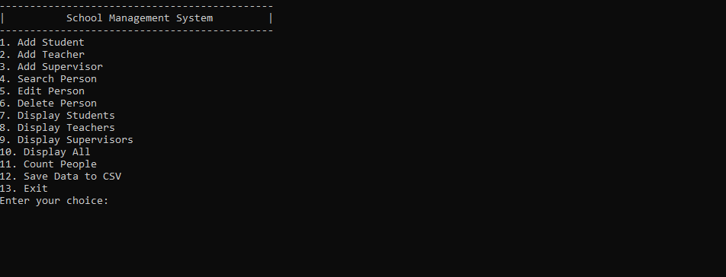
The student management system

Slide 9
User Guide
This a short review of the Student Management System Project
created by the Programmers Team to assist in the management of records for students.
The user will run the Exe file called Student management System and the program will open in a CMD Window , Like you see in the picture on top.
Then all the options are very simple to follow and use as it states what every step you input does.
Add Student: This option prompts the user to enter details for a new student, which would then be added to the database. The details could include name, age, grade, and other relevant information.
Add Teacher: Similar to the first option, but for adding a new teacher to the database. The details could include name, subject taught, years of experience, and other relevant information.
Add Supervisor: This would be for adding a new supervisor to the database. The details could include name, department, years of experience, and other relevant information.
Search Person: This option would allow the user to search for a person in the database by entering some identifying information, such as name or ID. The program then displays the details of the person if they are found in the database.
Edit Person: This allows the user to modify the details of an existing person in the database. The user would likely need to provide the ID or name of the person, and then enter the new details.
Delete Person: This removes a person from the database. The user needs to provide the ID or name of the person to delete their record.
Display Students: This displays a list of all students in the database, show their details such as name, age, grade, lessons.
Display Teachers: This displays a list of all teachers in the database, show their details such as name, subject taught, and years of experience.
Display Supervisors: This displays a list of all supervisors in the database, showing their details such as name, department, and years of experience.
Display All: This displays a list of all people in the database, regardless of whether they are a student, teacher, or supervisor.
Count People: This displays the total number of people in the database. It also provides a breakdown of the number of students, teachers, and supervisors.
Save Data to CSV: This saves the current state of the database to a CSV file. This file could then be used for backup purposes, or to transfer the data to another system.
Exit: This exits the program. Any unsaved changes might be lost, depending on how the program is designed.
This a short review of the Student Management System Project
created by the Programmers Team to assist in the management of records for students.
The user will run the Exe file called Student management System and the program will open in a CMD Window , Like you see in the picture on top.
Then all the options are very simple to follow and use as it states what every step you input does.
Add Student: This option prompts the user to enter details for a new student, which would then be added to the database. The details could include name, age, grade, and other relevant information.
Add Teacher: Similar to the first option, but for adding a new teacher to the database. The details could include name, subject taught, years of experience, and other relevant information.
Add Supervisor: This would be for adding a new supervisor to the database. The details could include name, department, years of experience, and other relevant information.
Search Person: This option would allow the user to search for a person in the database by entering some identifying information, such as name or ID. The program then displays the details of the person if they are found in the database.
Edit Person: This allows the user to modify the details of an existing person in the database. The user would likely need to provide the ID or name of the person, and then enter the new details.
Delete Person: This removes a person from the database. The user needs to provide the ID or name of the person to delete their record.
Display Students: This displays a list of all students in the database, show their details such as name, age, grade, lessons.
Display Teachers: This displays a list of all teachers in the database, show their details such as name, subject taught, and years of experience.
Display Supervisors: This displays a list of all supervisors in the database, showing their details such as name, department, and years of experience.
Display All: This displays a list of all people in the database, regardless of whether they are a student, teacher, or supervisor.
Count People: This displays the total number of people in the database. It also provides a breakdown of the number of students, teachers, and supervisors.
Save Data to CSV: This saves the current state of the database to a CSV file. This file could then be used for backup purposes, or to transfer the data to another system.
Exit: This exits the program. Any unsaved changes might be lost, depending on how the program is designed.

Slide 10
Thanks for watching

